Slide 1

Statistical Inference on lyft Fare price
MIDS IDS 702 FINAL PROJECT Presentation
By: Dean Huang
2020.11.15

Slide 2

Agenda
INTRODUCTION
PROBLEM STATEMENT
EXPLORATORY DATA ANALYSIS
MODEL SELECTION
TENTATIVE RESULTS

Slide 3


INTRODUCTION
ABOUT LYFT & CURRENT PRICING SYSTEM
One of most quintessential ridesharing companies in USA
31% share of US Market in September 2020
Despite being one of the ride sharing giant…
The ride charging method is still a myth….
Base Price
Cost/km
Cost/minute
Surge Multiplier
?

Slide 4
PROBLEM STATEMENT
ABOUT LYFT & CURRENT PRICING SYSTEM
Variable Names | Explanation
hour | Hour of the day.
day | Day of the month.
month | Month of the year.
name | Vehicle Model/Type: Lux , Lux Black, Lux Black XL, Lyft, Lyft XL, Shared (6 levels)
price | Price of the ride in dollars
distance | Distance traveled in miles.
surge_multiplier | Multiplier that is multiplied to the fare.
temperature | Temperature in Fahrenheit.
apparentTemperature | Apparent temperature in Fahrenheit.
windSpeed | Wind speed in miles per hour.
windGust | Wind gust in miles per hour
precipIntensity | Precipitation
icon | clear-day, clear-night, cloudy, fog, partly-cloudy-day, partly-cloudy-night, rain
destination | Destination of the ride.
source | Starting point of the ride.
Objectives
Measure the effects of time, temperature, weather, distance of the ride, and surge multiplier on the fare price of Lyft
Evaluate the impact of time, temperature, and weather on the surge multiplier
Highlight any additional interesting findings and associations…
Data Info
693, 071 rows← 50,000 observations randomly sampled
57 variables ←Picked 15 variables to analyze

Slide 5
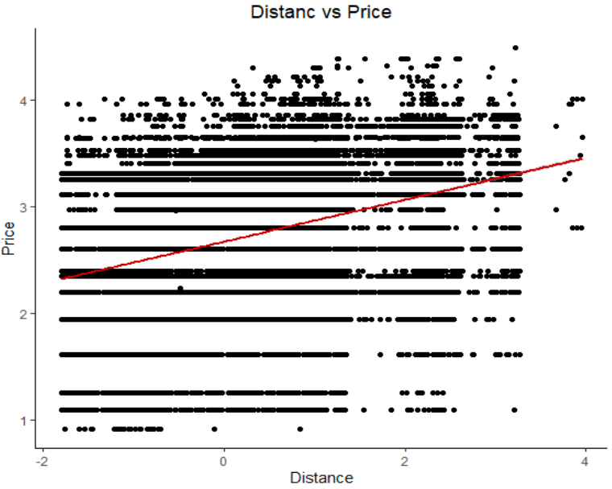
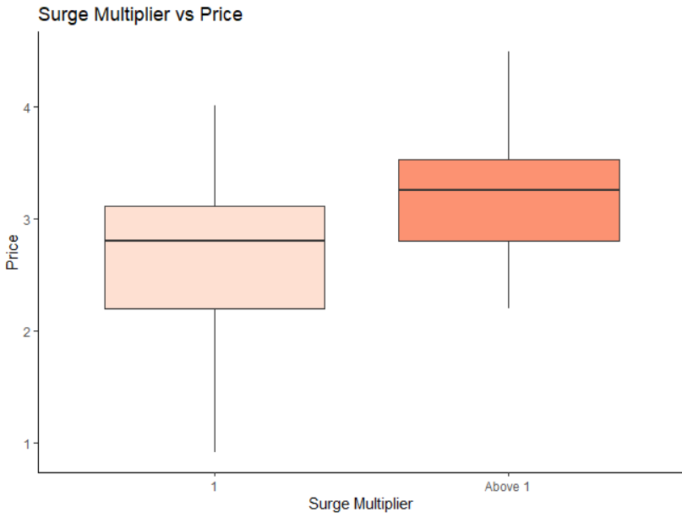
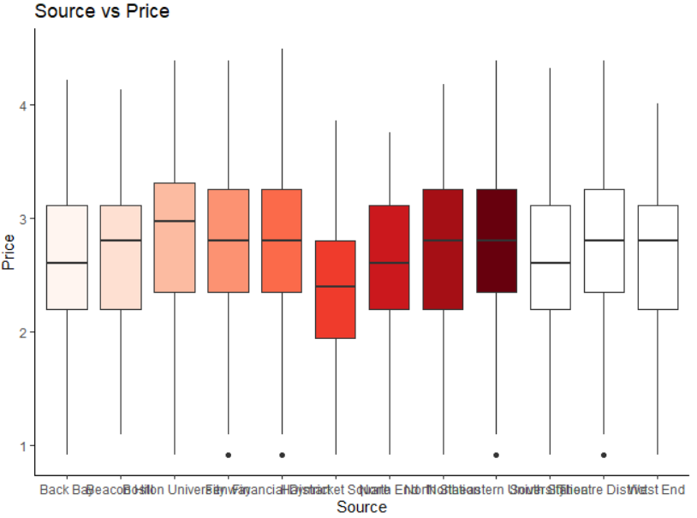
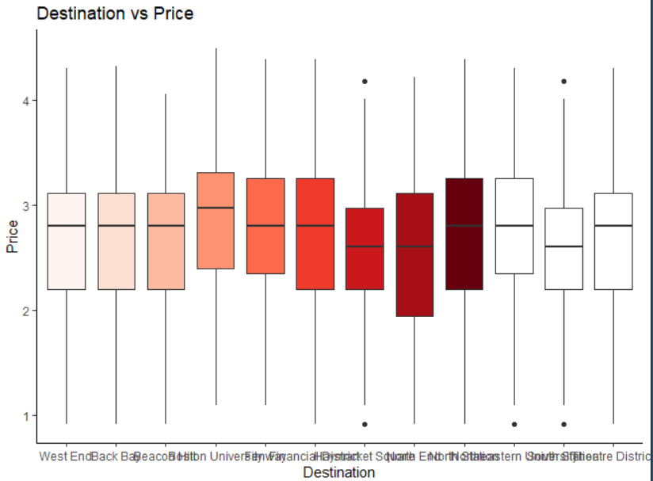
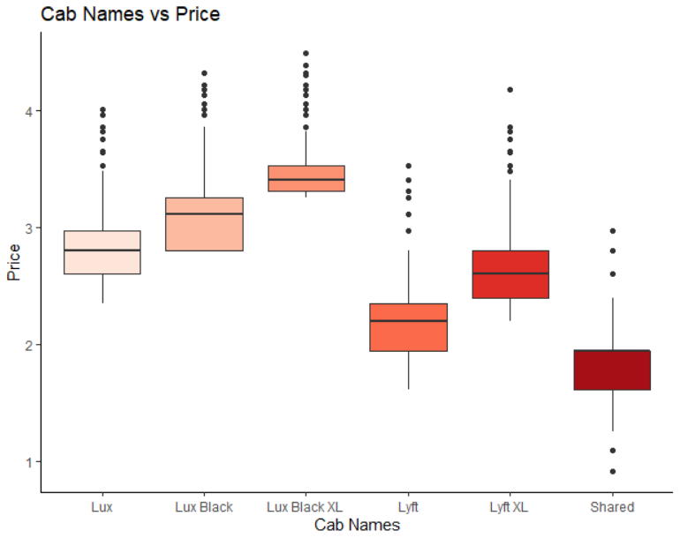
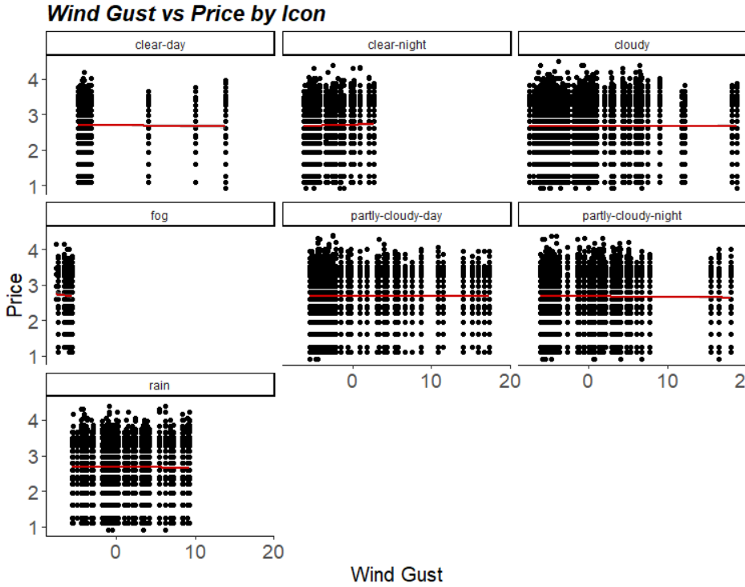
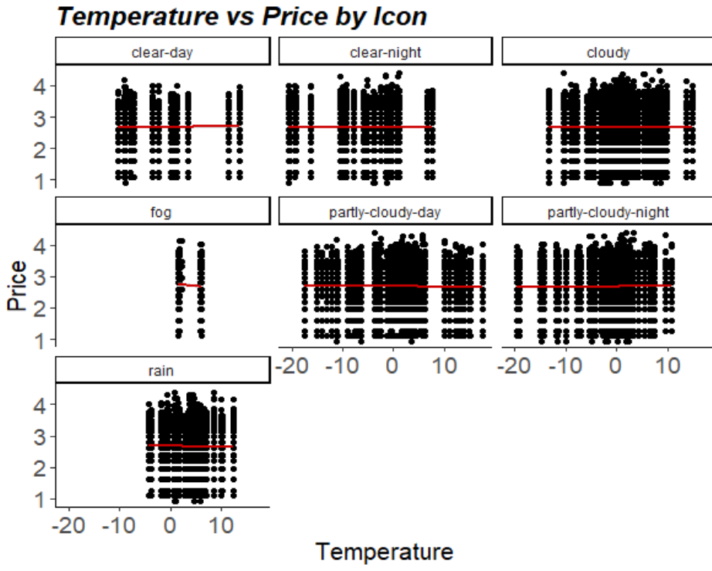
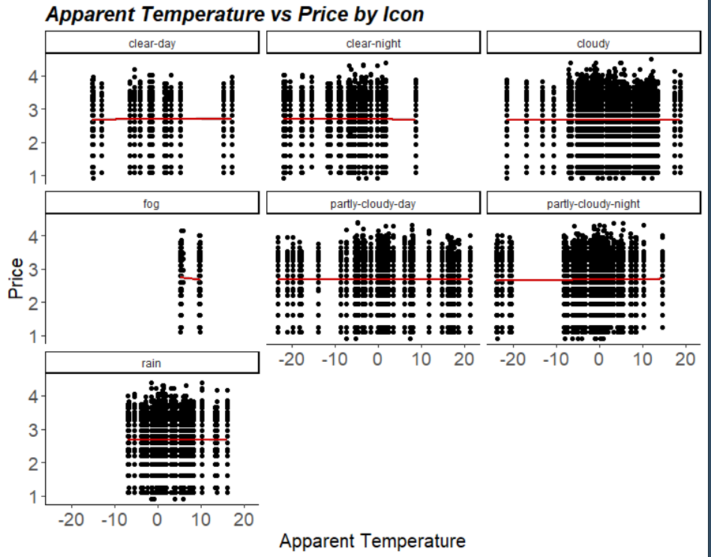
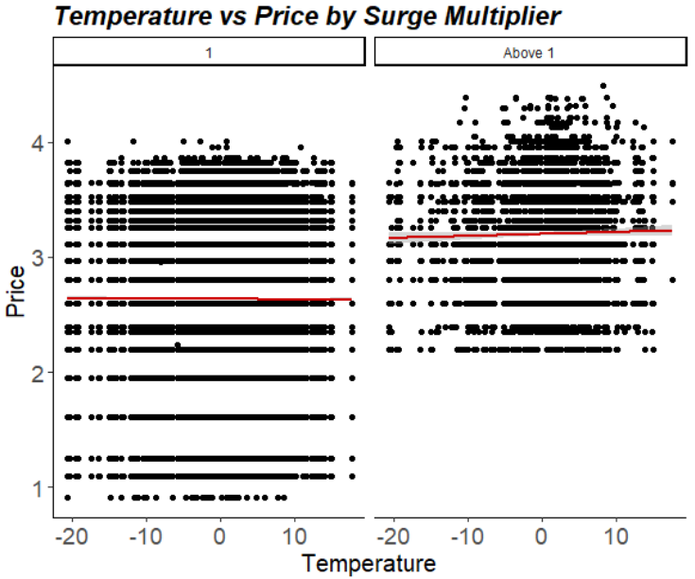
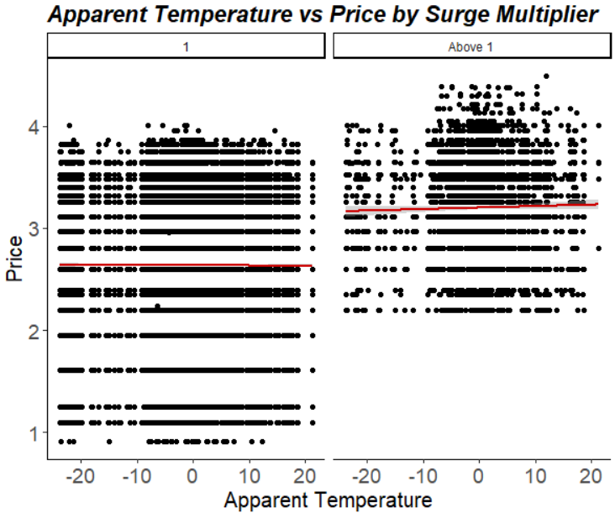
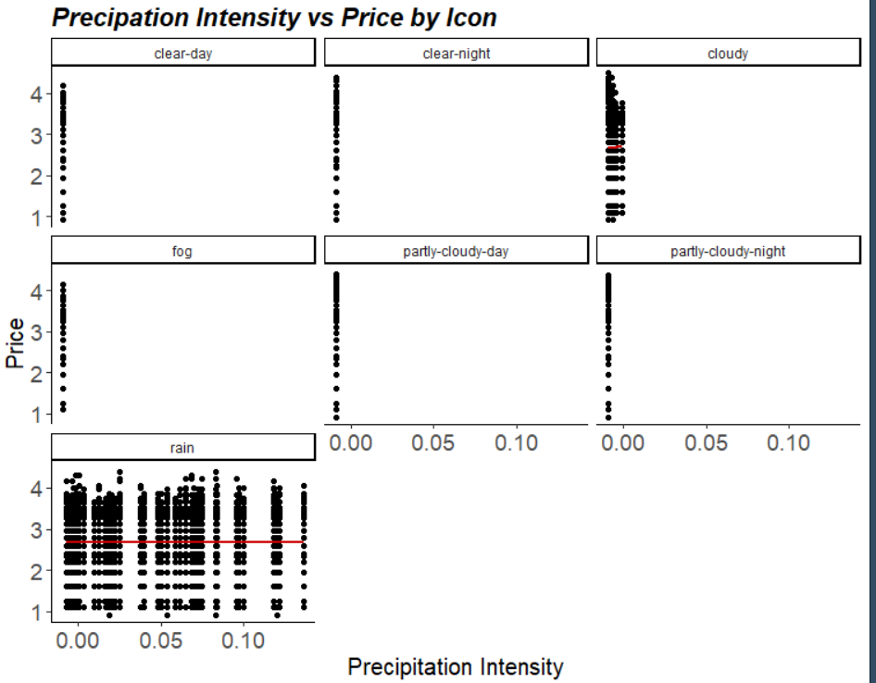
EDA
Highlight Interesting Findings
Convert hours to categorical variable…
Rush: 0700~0900, 1700~1900
Non-Rush: Rest of the time
Relevel Surge Multiplier (7 to 2)
‘Yes’: Surge multiplier greater than 1
‘No’: Surge multiplier equal to 1
Logarithmic transformation on price
Potential Associations
Distance
Name
Source
Destination
Surge Multiplier
Potential Interactions
Surge:Temperature
Surge:Apparent Temperature
Icon:Temperature
Icon:Apparent Temperature
Icon:PrecipIntensity
Icon:windGust

Slide 6
Model selection
Model Building Breakdown
Checking
Assumptions
Multicollinearity
& Outliers
Stepwise
Anova
√
Stepwise,
both sides
F-test, p-value
Full_Model:
Logprice ~ All fixed effects + Surge Multiplier Interactions + Name Interactions + Icon Interactions
Final_Model:
Logprice ~ name + distance + surge multiplier + destination + rush + name:rush + surge multiplier:destination + surge multiplier:distance

Slide 7
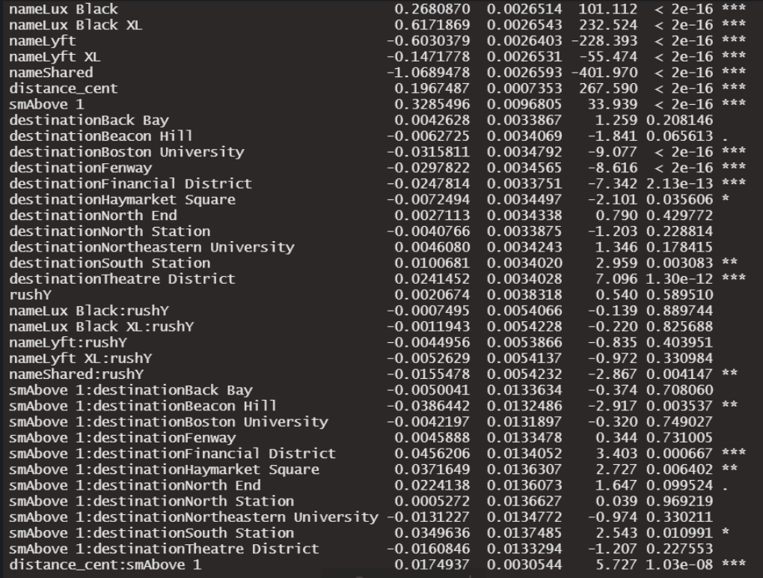
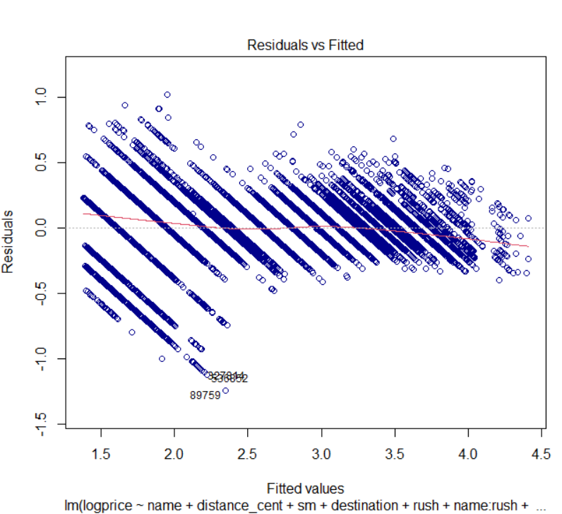
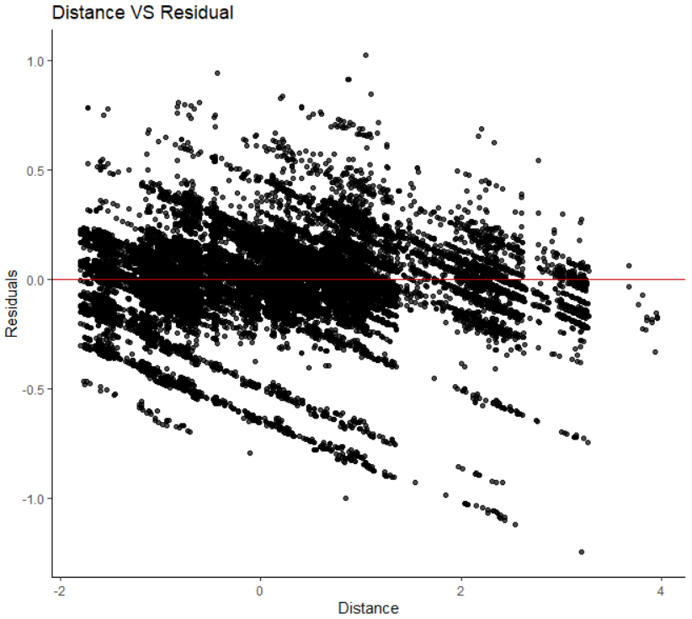
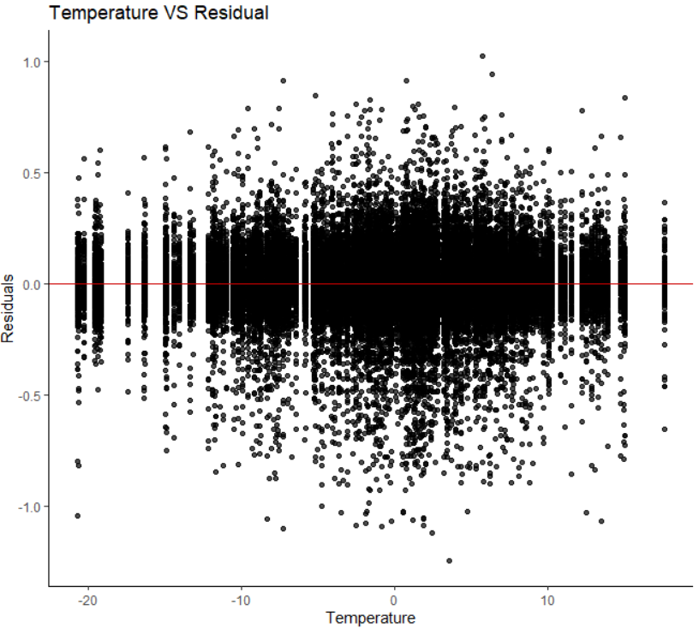
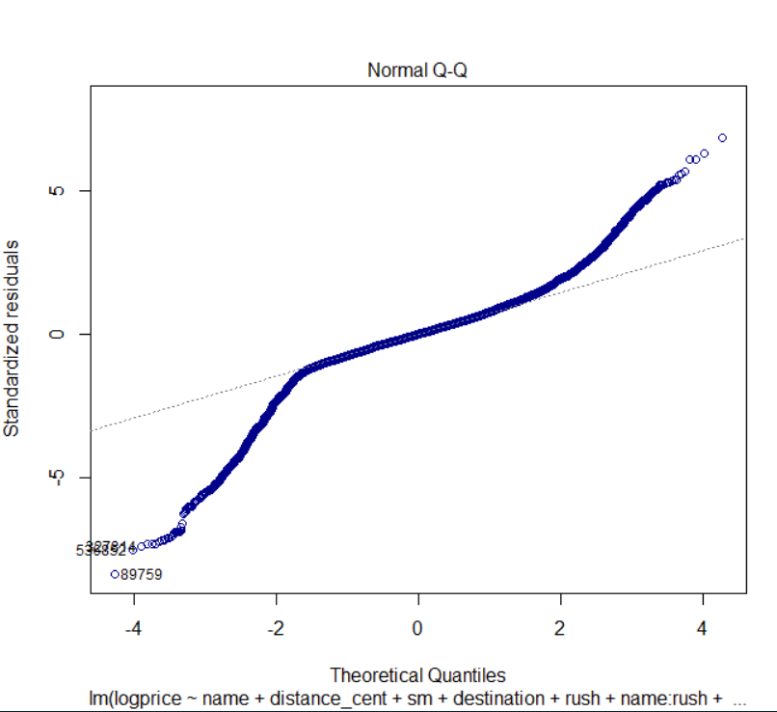
Tentative RESULTS
Potential Problems

Slide 8

THANK YOU

